Slide 1


Higher Failsworth Primary School
Writing Subject Leaders:
Mrs O’Mara, Miss Prendergast and Mrs Gately

Slide 2
Contents Page
Writing, Intent, implementation, impact statements
Writing threshold concepts
Writing Progression- spoken Language
Writing Progression- Reason for writing
Writing Progression- Audience
Writing Progression- Features of writing (part 1)
Writing Progression- Features of writing (part 2)
Writing Progression- Tone
Writing Progression- Spelling and Handwriting
Writing Cycle
Long term Plan
12. Handwriting Scheme
13. Genre Coverage
14. RAFT
15. Cover Sheets
16. Non- Negotiables

Slide 3
Writing Intent, Implementation and Impact Statements
Intent Statement | Implementation Statement | Impact Statement
English is a crucial part of our curriculum. It is our intention to ensure that all pupils regardless of background, gender, ability or additional need will access the key skills taught in English enabling them to approach materials in all curriculum areas with confidence. We intend to provide a strong foundation for their learning throughout their school career enabling learners to flourish and establish the skills they need to become confident and proficient readers and writers. We endeavour to fully equip our pupils with all the skills necessary so they are able to grow their knowledge and passion for the world by utilising their literacy skills making them a lifelong learner. | In EYFS the children take part in ‘Squiggle, wiggle’ and ‘Drawing club’ to develop mark making skills. In Reception and KS1 the children follow the RWI writing programme alongside the texts that they are using within the sessions. In the latter parts of KS1 and KS2, all classes follow a writing cycle which encourages plenty of oracy and vocabulary work followed by reading into writing. From the latter part of Y1 – Y6,we start each unit with RAFTs (Reason, Audience, Purpose, Tone and Spelling) This provides children with a success criteria for their end goal. Children are exposed to a WAGOLL which has been planned in advance by the class teacher to allow the children to identify the good features of the particular genre that they are focusing on. We then give the children opportunities to develop the vocabulary that may be included in a specific piece of writing. We try to play games and orally rehearse these words in lesson time. We then teach a key skill (Usually SPAG based) which is included in the RAFTs from earlier within the cycle. We teach this in context of the piece that we are writing. The children are then given time to plan and write their piece of writing, using the RAFTs continuously to focus the children throughout. After this, in KS1, we teach the children how to proofread and to start to make small changes and revision to their work, then in KS2 the children are taught to suggest improvements and make changes to their work to make corrections and enhance their writing. In addition to being referred to and taught alongside other subjects, Handwriting and Spelling is also taught discreetly to ensure our children are prepared and equipped with the skills to practise and produce a neat, legible and fluent style using explicitly taught spelling rules. | All pupils, regardless of background, gender, ability or additional need will have made progress from their starting points. Pupils enjoy English lessons and are keen, enthusiastic writers. Pupils have the knowledge and skills to write a variety of text types, being able to draw upon a range of internal structures of texts they have memorised. Pupils are able to write creatively and will do so independently. Pupils at HFPS will achieve alongside pupils in our Local Authority (Oldham) and at a National Level.

Slide 4
Writing - Threshold Concepts
Spoken Language
Spelling and Handwriting
Reason for Writing
Tone
Audience
Features of Writing

Slide 5
Writing Progression- Spoken Language
Year 1 and 2 | Year 3 and 4 | Year 5 and 6
Children's’ vocabulary will be developed when they listen to books read aloud and when they discuss what they have heard. Role play is used to help pupils identify and explore characters, and to try out language they have listened to. Question and sentence stems are used to develop and embed spoken vocabulary. Children will begin to speak audibly and fluently with an increasing command of Standard English Opportunities for public speaking in front of a wider audience are provided throughout the year through class assemblies, Collective Worship/Reflection; role play, circle time, PSHE, paired talk, presentations and show and tell Children will answer and ask questions predicting what might happen on the basis of what has been read so far and to extend their understanding and knowledge Children are aware of and follow agreed rules for effective discussion. Children will respond with increasing appropriateness to adults and their peers. | Children are given opportunities to discuss language, including vocabulary, extending children's’ interest in the meaning and origin of words. Children are encouraged to use drama approaches to perform plays and poems to support their understanding of the meaning. Effective use of vocabulary is used to gain and maintain the interest of the listener. Children can maintain attention and participate actively in collaborative conversations, staying on topic and initiating and responding to comments Children can speak audibly and fluently with an increasing command of Standard English Children can articulate and justify answers Children will ask relevant questions to extend their understanding and knowledge Children will consider and evaluate different viewpoints, attending to and building on the contributions of others Children develop, agree on and evaluate rules of effective discussion with the expectation that all pupils take part Children give well-structured descriptions, explanations and narratives for different purposes, including for expressing feelings. | Children can give well-structured descriptions, explanations and narratives for different purposes, including the expression of feelings Children can use relevant strategies to build their vocabulary e.g. use of descriptosaurus, ICT, dictionaries, thesaurus. Children can effectively and respectfully articulate and justify arguments and opinions. Children can use spoken language to develop understanding through speculating and hypothesising. Effective use of vocabulary is used to gain and maintain the interest of the listener. Children can speak audibly and fluently with an increasing command of Standard English Children can gain and maintain the interest of the listener Children will consider and evaluate and respond to different viewpoints, attending to and building on the contributions of others.

Slide 6
Writing Progression – Reason for Writing
Purpose for Writing | EYFS (Verbal with some written) | Y1 (Independent Writing) | Y2 (Independent Writing) | Y3 (Independent Writing) | Y4 (Independent Writing) | Y5 (Independent Writing) | Y6 (Independent Writing)
To Entertain | Labels and Captions Description Story (Retell) Poetry | Labels and Captions Description Story (Retell & some innovation) Poetry | Description (character and setting) Story (Retell & some innovation) Poetry | Description (character and setting) Story Poetry | Description (character and setting) Story Poetry | Description (character and setting) Story Poetry | Description (character and setting) Story Poetry
To Inform | Labels and Captions Recounts Letters Lists | Labels and Captions Recounts Letters Fact Files Instructions | Recounts Letters Non-chronological reports Instructions | Diaries Letters Non-chronological reports Instructions Biography | Diaries Letters Non-chronological reports Instructions Explanation Biography | Diaries Letters Reports Instructions Explanation Biography | Diaries Letters Reports (including formal and mixture) Instructions Explanation Biography
To Persuade |  |  |  | Advertising Simple Letter | Letter Speech | Letter Speech | Letter Speech (including formal)
To Discuss |  |  |  |  |  | Argument Review | Argument (including formal) Review Debate

Slide 7
Writing Progression – Audience
Year 1 and 2 | Year 3 and 4 | Year 5 and 6
Children can discuss what they have written with the teacher or other pupils Children can read their writing aloud, clearly enough to be heard by their peers and the teacher Children will develop positive attitudes towards and stamina for writing Children can begin to write narratives about personal experiences and those of others (real and fictional); real events; poetry Children will write for different purposes Children can read aloud what they have written with appropriate intonation to make the meaning clear | Children will begin to plan and write with an understanding of purpose and audience. Children will show increasing confidence when reading their own writing aloud to a group or the whole class. Pupils should continue to have opportunities to write for a range of real purposes and audiences as part of their work across the curriculum. These purposes and audiences should underpin the decisions about the form the writing should take, such as a narrative, an explanation or a description. | Children can write for a range of purposes and audiences confidently, selecting appropriate grammar and vocabulary to match the purpose. Children can produce sustained and accurate writing from different narrative and nonfiction genres with appropriate structure Children can plan their writing with increasing confidence by identifying the audience for and purpose of the writing, selecting the appropriate form and using other similar writing as models for their own

Slide 8
Writing Progression – Features of Writing (1 of 2)
Year 1 | Year 2 | Year 3 | Year 4 | Year 5 | Year 6
To write sentences in order to create short narratives and non-fiction texts. To use some features of different text types To use adjectives to describe To use simple sentence structures To use the conjunction, ‘and’ to link ideas and sentences. To use capital letters for names, places, days of the week and the personal pronoun, ‘I’. Finger spaces Full stops to end sentences Question marks Exclamation marks | Pupil(s) can write a simple, coherent narrative about their own and others’ experiences (real and fictional), after discussion with the teacher: writing about real events, recording these simply and clearly demarcating most sentences with: capital letters and full stops and with use of: question marks. using present and past tense mostly correctly and consistently using co-ordination (or / and / but) using some subordination (when / if / that / because) | To begin to use ideas from own reading and modelled examples to plan their writing. To demonstrate an increasing understanding of purpose and audience. To begin to use the structure of a wider range of text types (including the use of simple layout devices in non-fiction). To proofread their own and others’ work to check for errors with increasing accuracy, and make improvements. To make deliberate ambitious word choices to add detail. To begin to create settings, characters and plot in narratives. To begin to organise their writing into paragraphs around a theme. | To write a range of narratives and non-fiction pieces using a consistent and appropriate structure (including genre-specific layout devices). To write narratives with a clear beginning, middle and end with a coherent plot. To proofread confidently and amend their own and others’ writing, e.g. adding in nouns/pronouns to avoid repetition, recognising where verbs and subjects do not agree or lapses in tense. To create more detailed settings, characters and plot in narratives to engage the reader. To consistently organise their writing into paragraphs around a theme. | To write for a range of purposes and audiences, confidently selecting structure and organisation of a text depending on audience and purpose. To describe settings, characters and atmosphere to consciously engage the reader. To use dialogue to convey a character and advance the action with increasing confidence. To select and use organisational and presentational devices that are relevant to the text type, e.g. headings, bullet points, underlining, etc. To begin to proofread work to précis longer passages by removing unnecessary repetition or irrelevant details. To create paragraphs that are usually suitably linked. To proofread their work and assess the effectiveness of their own and others’ writing and make necessary corrections and improvements. | The pupil can write effectively for a range of purposes and audiences, selecting language that shows good awareness of the reader (e.g. the use of the first person in a diary; direct address in instructions and persuasive writing): in narratives, describe settings, characters and atmosphere integrate dialogue in narratives to convey character and advance the action

Slide 9
Writing Progression – Features of Writing (2 of 2)
Year 1 | Year 2 | Year 3 | Year 4 | Year 5 | Year 6
 |  | To maintain the correct tense (including present perfect tense) throughout a piece of writing. To use the full range of punctuation from previous year groups. To use inverted commas in direct speech. To use subordinate clauses. To begin to use conjunctions, adverbs and prepositions to show time, place and cause. To use ‘a’ or ‘an’ correctly most of the time. | To maintain an accurate tense throughout a piece of writing. To use Standard English verb inflections accurately, e.g. ‘we were’ rather than ‘we was’, ‘I did’ rather than ‘I done’. To use the full range of punctuation from previous year groups. To use all the necessary punctuation in direct speech mostly accurately. To use apostrophes for singular and plural possession with increasing confidence. To expand noun phrases regularly with the addition of modifying adjectives and prepositional phrases, e.g. the strict teacher with curly hair. To regularly choose nouns or pronouns appropriately to aid cohesion and avoid repetition, e.g. he, she, they, it. To use fronted adverbials, e.g. As quick as a flash, Last weekend; usually demarcated with commas. | To use the full range of punctuation from previous year groups. To use commas to clarify meaning or to avoid ambiguity with increasing accuracy. To use a wider range of linking words/phrases between sentences and paragraphs To build cohesion including time adverbials, e.g. later; place adverbials, e.g. nearby; and number, e.g. secondly. To use relative clauses beginning with a relative pronoun (who, which, where, when, whose, that) To use brackets, dashes or commas to begin to indicate parenthesis. To use adverbs and modal verbs to indicate degrees of possibility, e.g. surely, perhaps, should, might, etc. | To select vocabulary and grammatical structures that reflect what the writing requires, doing this mostly appropriately (e.g. using contracted forms in dialogues in narrative; using passive verbs to affect how information is presented; using modal verbs to suggest degrees of possibility) To use a range of devices to build cohesion (e.g. conjunctions, adverbials of time and place, pronouns, synonyms) within and across paragraphs To use verb tenses consistently and correctly throughout their writing To use the range of punctuation taught at key stage 2 mostly correctly (e.g. inverted commas and other punctuation to indicate direct speech)

Slide 10
Writing Progression – Tone of Writing
Year 1 and 2 | Year 3 and 4 | Year 5 and 6
Children can read aloud what they have written with appropriate intonation to make the meaning clear. | Children can read their own writing aloud to a group or the whole class, using appropriate intonation and controlling the tone and volume so that the meaning is clear. Children are beginning to write according to the tone of the piece of writing including atmosphere. | Perform their own compositions, using appropriate intonation, volume, and movement so that meaning is clear. Children can write in an atmospheric way which is appropriate to the tone of the writing outcome.

Slide 11
Writing Progression – Spelling and Handwriting
Year 1 | Year 2 | Year 3 | Year 4 | Year 5 | Year 6
To spell most words containing previously taught phonemes and GPCs accurately. To spell most Y1 common exception words and days of the week accurately (from English Appendix 1). To use -s and -es to form regular plurals correctly. To use the prefix ‘un’. To add the suffixes –ing, -ed, -er and –est to root words (with no change to the root word). To write lower case and capital letters in the correct direction, starting and finishing in the right place. To write lower case and capital letters in the correct direction, starting and finishing in the right place with a good level of consistency. | Segmenting spoken words into phonemes and representing these by graphemes, Spelling many of these words correctly and making phonically-plausible attempts at others Spelling many KS1 common exception words Writing capital letters and digits of the correct size, orientation and relationship to one another and to lower-case letters Using spacing between words that reflects the size of the letters | To spell many words with prefixes correctly, e.g. irrelevant, autograph, incorrect, disobey, superstar, antisocial. To spell many words with suffixes correctly, e.g. usually, poisonous, adoration. To begin to spell homophones correctly, e.g. which and witch. To spell some of the Year 3 and 4 statutory spelling words correctly. To use a neat, joined handwriting style with increasing accuracy. | To spell all words with prefixes correctly, e.g. irrelevant, autograph, incorrect, disobey, superstar, antisocial. To spell all words with suffixes correctly, e.g. usually, poisonous, adoration. To spell homophones correctly, e.g. which and witch. To spell all of the Year 3 and 4 statutory spelling words correctly. To consistently use a neat, joined handwriting style. | To spell many verb prefixes correctly, e.g. deactivate, overturn, misconduct, etc. To convert nouns or adjectives into verbs using suffixes, e.g. designate, classify, criticise, etc. To spell many complex homophones correctly, e.g. affect/effect, practice/practise, etc. To spell many words correctly from the Y5/6 statutory spelling list. To write legibly, fluently and with increasing speed. | To spell correctly most words from the year 5 / year 6 spelling list,* and To use a dictionary to check the spelling of uncommon or more ambitious vocabulary To maintain legibility in joined handwriting when writing at speed.

Slide 12
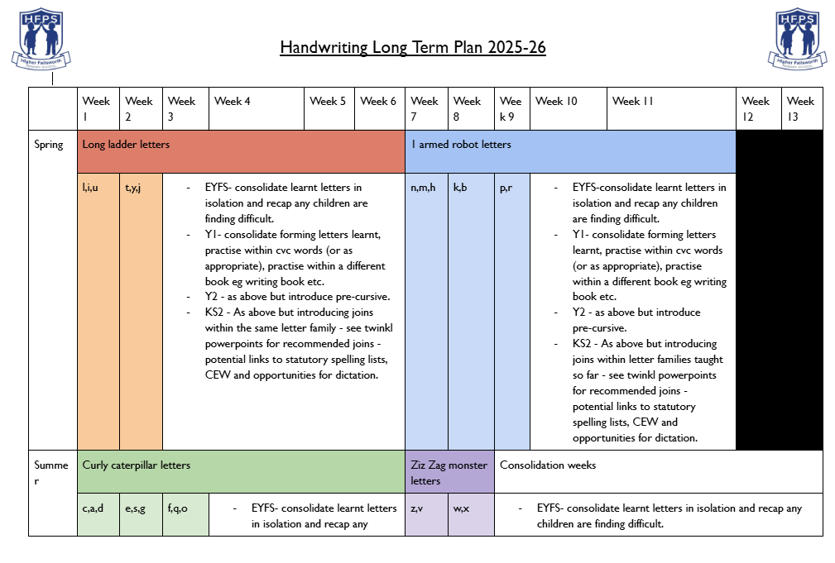
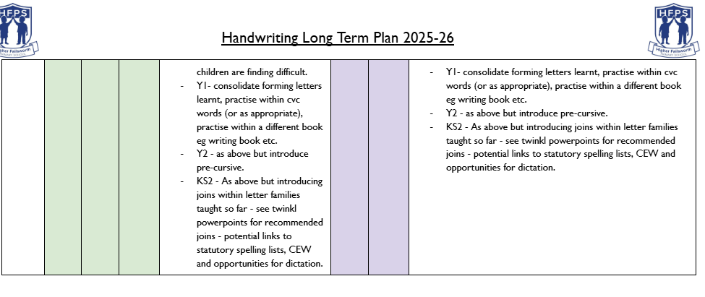
Handwriting Scheme
https://docs.google.com/document/d/1jpMscgahNx7G-nT7Xq6l4-vikMVMQrGVloTYVHxJY7E/edit?usp=sharing

Slide 13
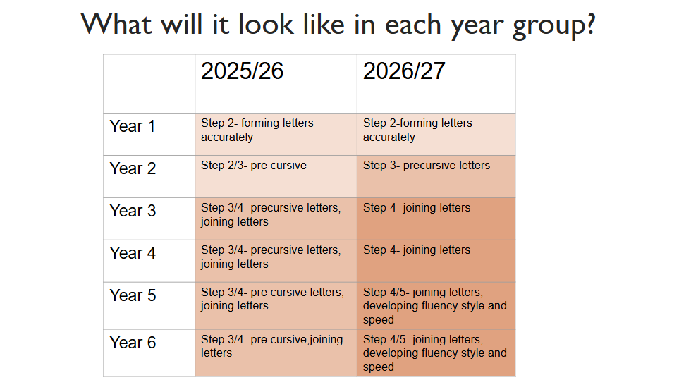

Slide 14
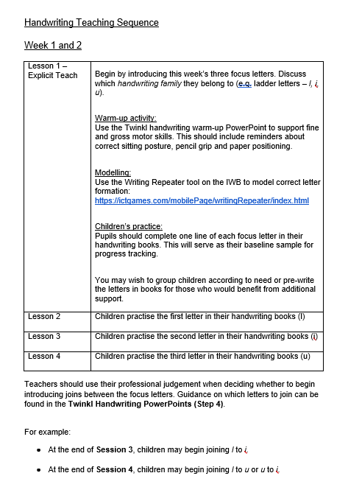
Sequence of handwriting lessons example
https://docs.google.com/document/d/12fxaMd7BOdJpMNr7DYEJwB4RxmY8W_RLNOeq_A0CXQo/edit?usp=sharing

Slide 15
Writing Cycle: Y1(Spring 1) – Y6
Hook
Word Work
Key Skill
Planning
Writing, Editing, Proofreading
Writing, Editing, Proofreading
Pupils are introduced to RAFTs (Reason, Audience, Features, Tone, Spelling) for the genre being taught.
They will take part in an immersion activity directly linking to the piece that they will write.
Pupils will explore effective vocabulary, effective phrases and statutory spellings linking with the writing piece. These should be immersive and if possible game based to ensure retention of effective vocabulary.
We will teach features that have been taken from the RAFTs. Usually 2 keys kills will be taught (this may be a revisit of an old key skills which is not yet secure) This key skill will be taught within context of the piece being written.
At this stage the teacher will start by model planning a WAGOLL. They will think aloud to model the planning process. The children will then plan their own piece of writing based on this modelled plan. There may be an opportunity for a teacher shared write at this point to model WAGOLL
The children will independently write from their plan the previous sessions. The children will use an assessment grid to support with their content. This will be self assessed at the end of each session and then teacher assessed. The children will then be given the opportunity to make correction/ enhancements as required.
If appropriate we allow the children to share and celebrate their achievement within their writing. This may be sent to the author, published on the school Twitter feed, instagram etc It may be sent home to parents via a photocopy of a QR code etc.

Slide 16
Writing Long Term Plan*
*Content is subject to change depending on the needs of the school and children
 | Autumn 1 | Autumn 2 | Spring 1 | Spring 2 | Summer 1 | Summer 2
EYFS | Story Retell Poetry | Story Retell Description | Story Retell Poetry | Story Retell Description | Story Retell Poetry | Story Retell Description
Reception | Story Retell Poetry | Story Retell | Story Retell Lists | Labels and Captions Description | Labels and Captions Poetry | Recount
Year 1 | Writing through RWI Scheme | Writing through RWI Scheme | Instructions Story writing Recount of visit | Character description Setting description Letter writing | Story Writing Non- Chronological report | Instructions Story writing Poetry writing
Year 2 | Descriptive writing Letter writing (postcards) Poetry- Calligram | Instructions Story Writing Recount of visit | Non chronological report Story writing Letter writing | Setting description Recount of visit | Poetry- Acrostic Non Chronological report Character description | Instructions Letter writing Story Writing
Year 3 | Character description Story writing Instructions | Story writing Non-Chronological report | Letter Instructions | Setting description Story writing | Persuasive letter Non-Chronological report | Story Poetry Speech
Year 4 | Story writing DIary | Setting description Story writing Persuasive letter | Story writing Character description | Letter Non-Chronological Report | Recount Instructions | Poetry Letter
Year 5 | Persuasive Text Poetry Description | Story Writing Diary instructions | Story writing Non-Chronological Report | Letter Diary | Description Persuasive letter | Story writing Instructions Poetry
Year 6 | Letter Story writing Diary | Description Story writing Recount | Missing Person’s Report Speech Non-chron report | Letter Story Description | Consolidation of punctuation and grammar skills | letter Description Debate

Slide 17
Genre Coverage
Working as a team, we have created a genre coverage document which ensures that we have breadth of coverage of a range of genres over the course of the academic year. We strive to ensure that we are able to teach specific skills within the early stages of the year and then allowing the children to work more independently as the year progresses. This allows us to make accurate assessments and judgements as the children are exposed to the genres multiple times during the year.

Slide 18
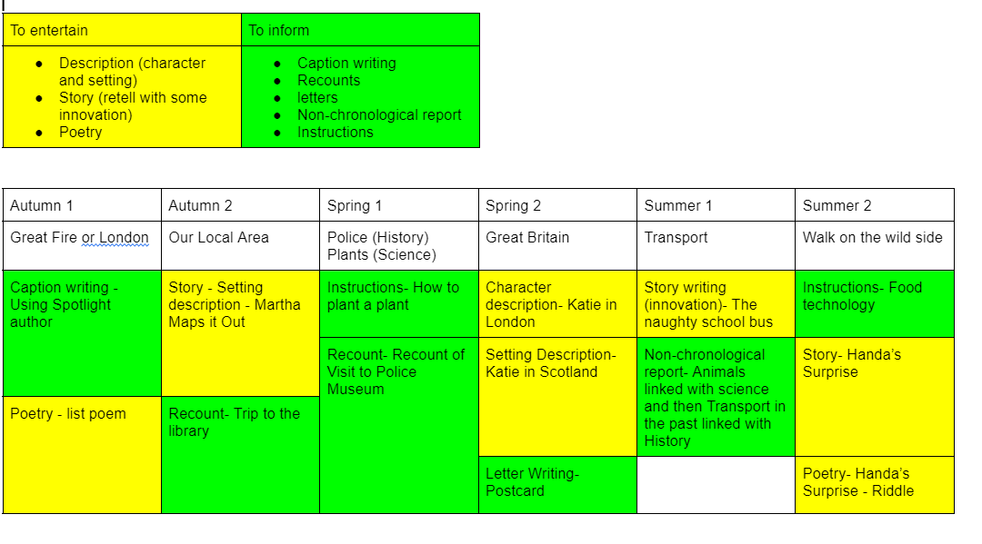
Year 1 Genre Coverage

Slide 19
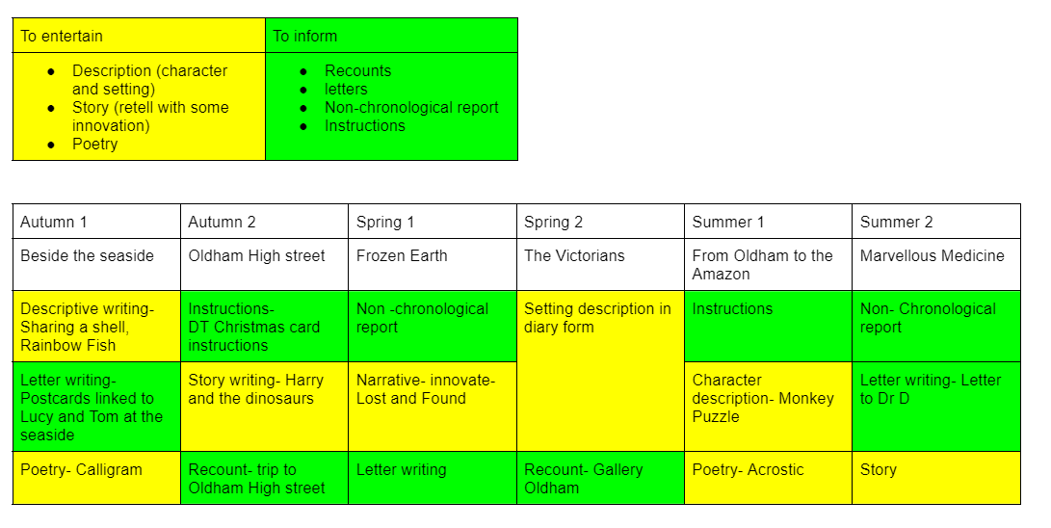
Year 2 Genre Coverage

Slide 20
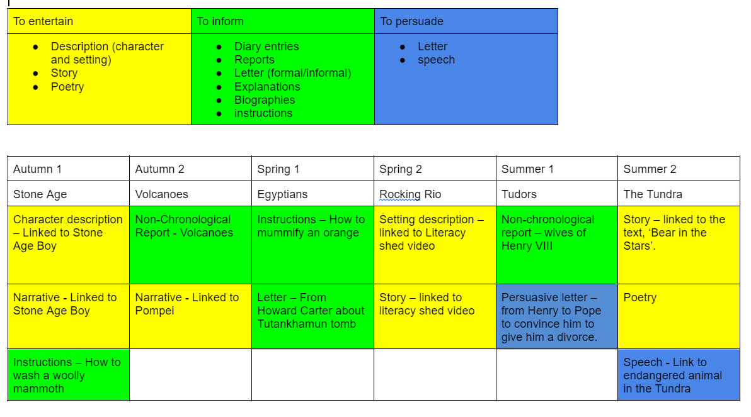
Year 3 Genre Coverage

Slide 21
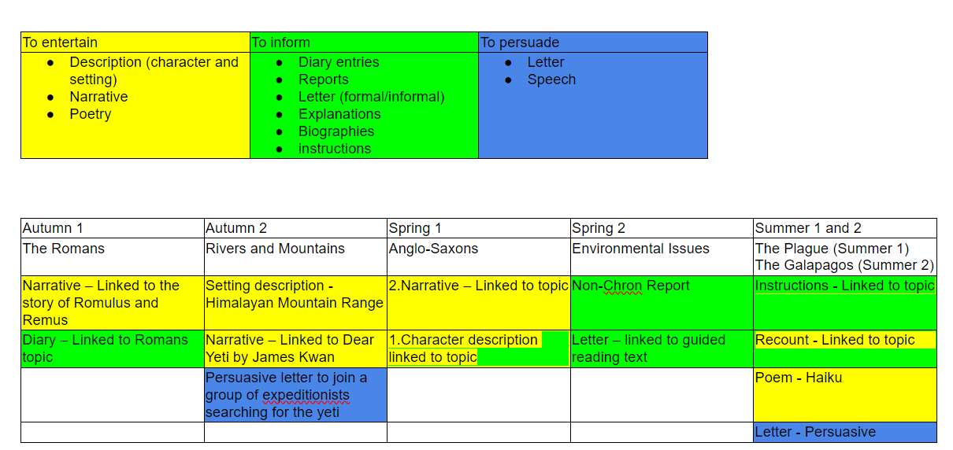
Year 4 Genre Coverage

Slide 22
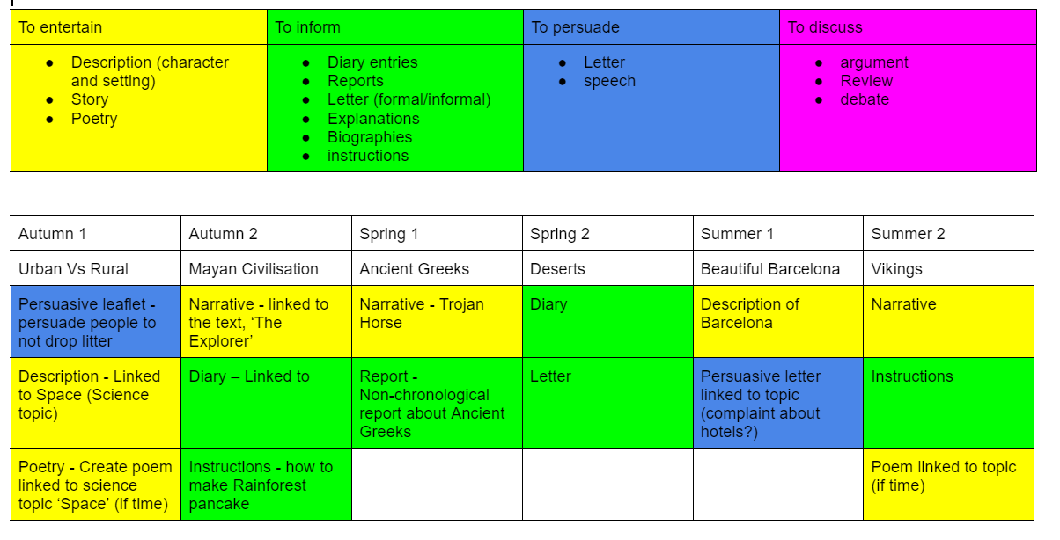
Year 5 Genre Coverage

Slide 23
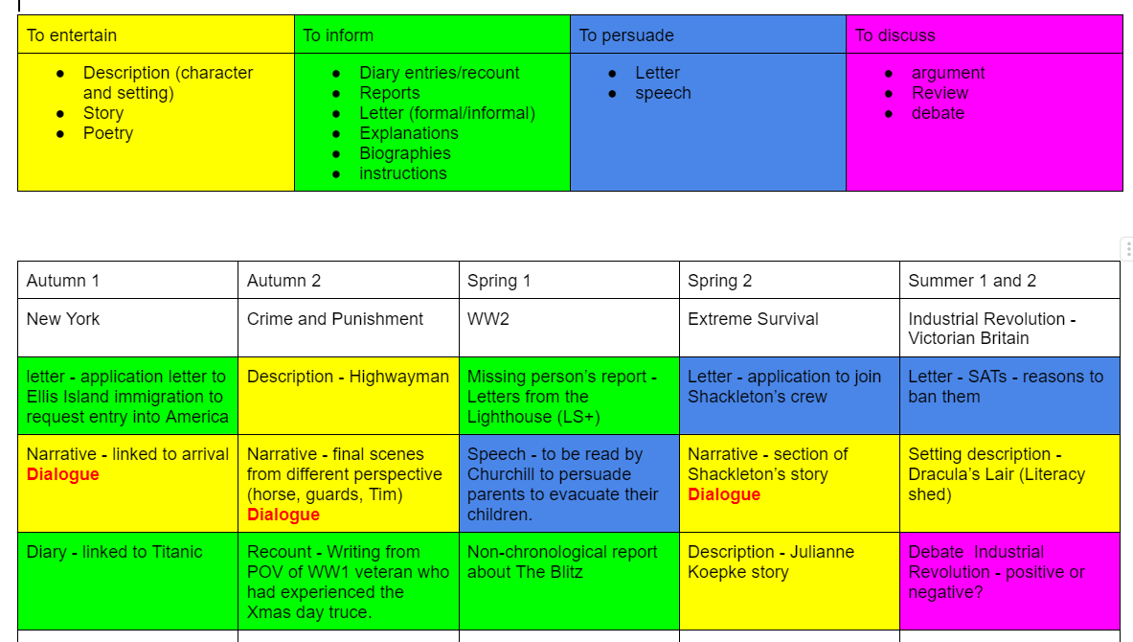
Year 6 Genre Coverage

Slide 24
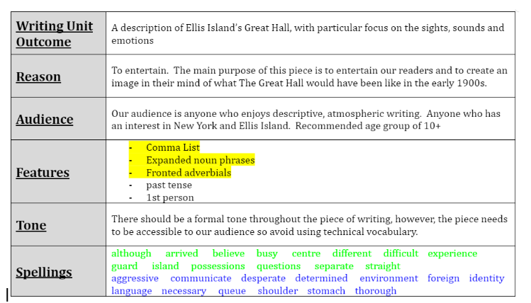
RAFT
The purpose of the RAFT is…
Example

Slide 25
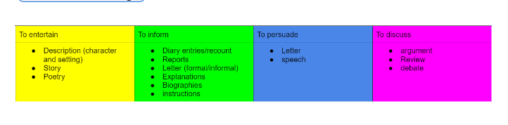
Reason
REASON -
The reason for writing should always be at least one of the following:
To entertain
To inform
To persuade
To discuss
Our genre coverage documents found in the year group LTP section of the writing folder shows the reason for writing for each year group.
https://drive.google.com/drive/folders/1lyVQcjBaWJCOuHoeTwNN04fIL6liikAc?usp=drive_link

Slide 26
Audience
AUDIENCE-
The audience for a piece of writing is always who we are writing it for.
Who is the target audience for this piece of writing?
Who would enjoy reading this piece?
Is there a particular age group you think it would be appropriate for?
Would this piece appeal to people with particular interests?
Would this piece appeal to people who enjoy a certain style of writing?

Slide 27
Features
FEATURES-
The features of a piece of writing are the technical bits that we want children to show off.
The Key skills that you are teaching specifically for this piece need to be highlighted on the cover sheet RAFT. This helps the writing team to know what the focus is when doing book looks.
Any skills that you want to be included in the piece but you aren’t specifically teaching this time (because you’ve already covered it) don’t need to be highlighted.
The writing team (with help from teachers) have made a start on a progression of key skills document for each year group. This should help if you’re not sure what key skill to focus on. This document is in the progression folder of the writing section on the drive. Here’s the link…
https://drive.google.com/drive/folders/1Z56ccjC61nTdT7xpV_0BVoA2X2YXjyYV?usp=drive_link

Slide 28
Tone
TONE
This part of the RAFT is about the feeling of the piece of writing.
Lower down school it would possibly be best just to get children to think about whether they are going to be ‘posh’ or not in their writing and get them to understand that sometimes they need to be ‘posh’ (report or an important letter) and sometimes they don’t need to be ‘posh’ (a diary or a letter to friend).
Higher up school, children need to be used to the idea of being formal and informal in their writing and using opportunities to switch formality (in a narrative).
As well as formality, tone also links to the feeling you want the reader to have - should there be an element of suspense, eeriness, humour in the writing?

Slide 29
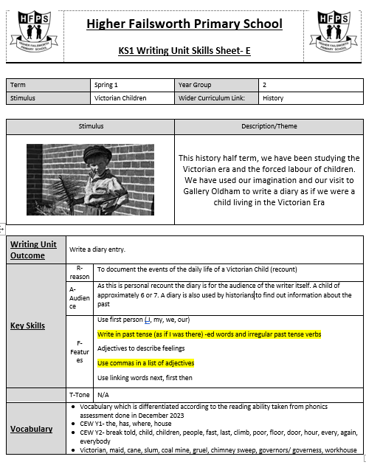
Some example cover sheets

Slide 30
Non-negotiables
Classroom resources
RAFT displayed in the classroom
Spelling words that are the focus for the particular genre that you are teaching
EYFS
Writing opportunities throughout CP
A range of writing utensils
KS1
Phonics sounds mats
Phonics word cues- fred fingers etc
KS2
Access to dictionaries and thesaurus

Slide 31
Non-negotiables continued
Genre coverage
It is essential that we stick to the writing genre coverage for your year group. This is so we can confidently say we are teaching what we say we are teaching.
If you need to change something on the genre coverage sheet then please discuss it with one of the writing team - we can always jiggle things around but we need to make sure that we have got sufficient coverage of each genre in each year group.
Here’s the link to the genre coverage folder
https://drive.google.com/drive/folders/1lyVQcjBaWJCOuHoeTwNN04fIL6liikAc?usp=drive_link

Slide 32
Non-negotiables continued
Skills Progression
When planning your writing topic, please refer to the skills progression document for your year group. The key skills on your RAFT should match the ones listed on the document. Please highlight the key skills you have taught as part of your current writing topic in yellow.
Here’s the link to the skills progression folder
https://drive.google.com/drive/u/0/folders/1Z56ccjC61nTdT7xpV_0BVoA2X2YXjyYV

Slide 33
Non-negotiables continued
Books for all children(KS1/KS2)
Cover sheet (see examples included)
Key skill being taught on cover sheet- highlight current key skill being taught and leave previous key skills blank if they have been included
Spelling words that are being taught on cover sheet
UKS2 - Y3/4 words in green, Y5/6 words in blue
LKS2 - Y2 CEW in green, YR3/4 words in blue
There should be evidence of the writing sequence being followed:
Some vocabulary work
Key skill work (should be linked to the writing you are doing, not just random work sheets)
Planning
Writing

Slide 34
Non-negotiables continued
Assessment
Assessment grid - this should contain the following:
The key skills you are assessing against in this piece.
Have they written in the correct tense?
Have they used the appropriate person throughout the piece?
Is there evidence of year group spellings (from cover sheet) being used?
Has punctuation that has already been taught been used accurately?
KS2 - is there evidence of correct tone being used?
Assessment grids should be stuck in after children’s writing. It is OK to share the assessment grids before writing begins, but as there were concerns about it being viewed as a ‘checklist’, then let’s stick it in after. If more than one paragraph is being written, an assessment grid should be stuck in after each paragraph so children are aware of how they can improve their writing.
Teachers to use red, yellow and green to assess a piece of writing.
Red - no evidence
Yellow - some evidence but not consistently used
Green - evidence of this being consistently used
After each piece, complete the assessment tracker for your class - see the link to the folder below.
https://drive.google.com/drive/folders/1oxGO0A9Z2oM5r_93gJaEsUi2z-Hv5klX?usp=drive_link

